Slide 2
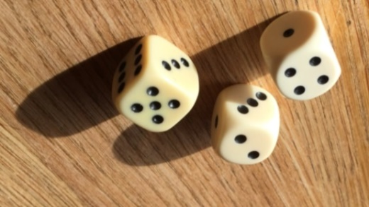
1.7 Dice Games
Objectives
The participants learn all about a dice.
The participants learn to construct a cube from a net of a cube.
The students learn how a cube is transformed into a gambling dice.
Tools, Materials and Organisation
Groups of 3 to 5 persons are sitting around a table.
On each table are three dice, a shaker, notepaper and a pencil.
For the construction of a cube you need paper, scissors and glue.

Slide 3
1.7 Dice Games
Description of the Lesson
First part of the lesson (20 minutes)
Make groups of 3 to 5 participants.
Choose two from the compendium of 10 dice games
Play the game several times and note the winner.
Which game is the most funny or exciting one?
Second part of the lesson (25 minutes)
The participants construct their own cube or dice from a net of a cube.
Each participant gets one worksheet, ruler and pencil, scissors and glue.
Follow the instruction on the worksheet.
Useful Hints
It is necessary, that each participant is constructing his own cube and dice – this is learning by doing!
Interesting fact: The sum of two opposite sides of the points of a dice is always 7.

Slide 4
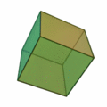
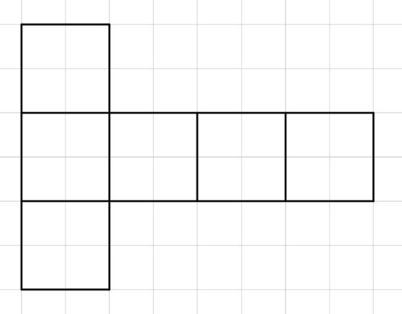
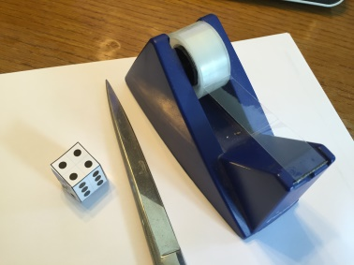
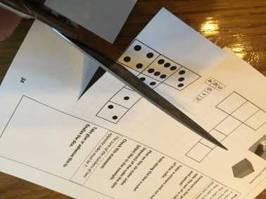
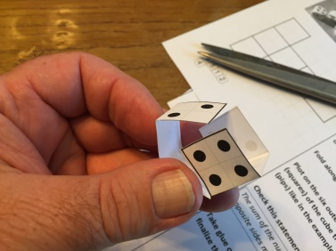
1.7 Dice Games
What is a cube?
A cube is a geometric object with the following characteristics:
The cube is three dimensional.
The cube is bounded by six square faces (six square sides).
Construct in the grid on the left side the net of a cube with ruler and pencil!
Plot on the six outer sides (squares) of the cube the dots (pips) like in the example.
Remember: The sum of the points of two opposite sides must be always 7.
Take scissors and cut out the net of the cube.
Fold along the line to make a cube!
Take glue or adhesive film to finish the dice.

